Slide 1
Crisis Communications
Ann Marie Varga – Spokesperson – Florida

Slide 2
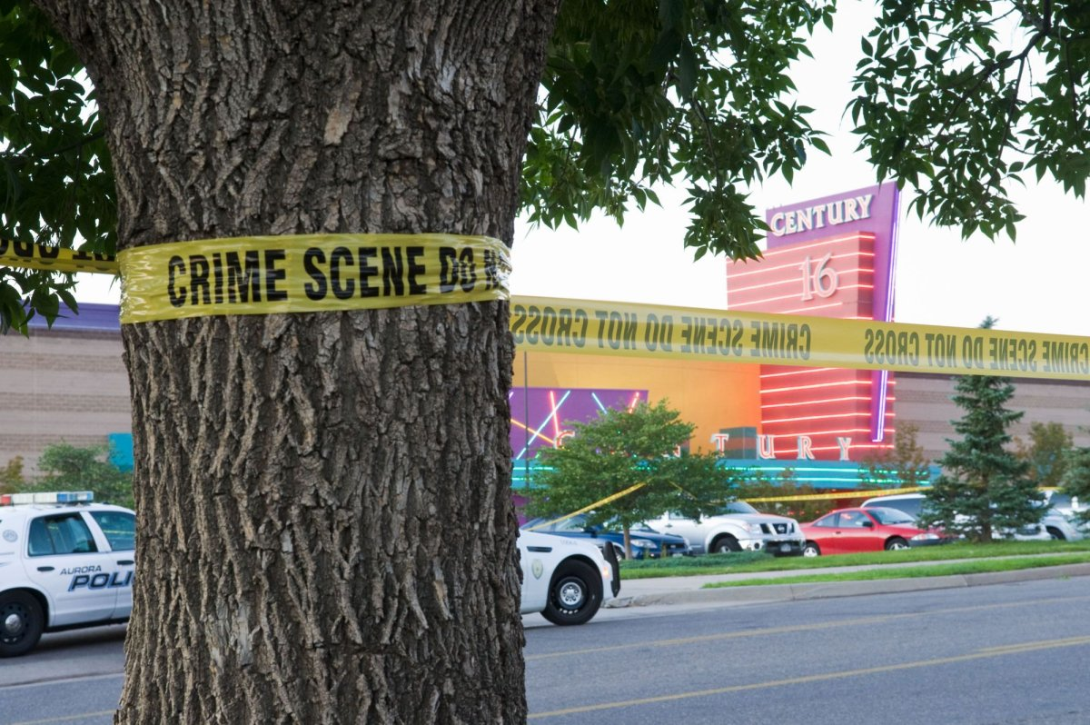
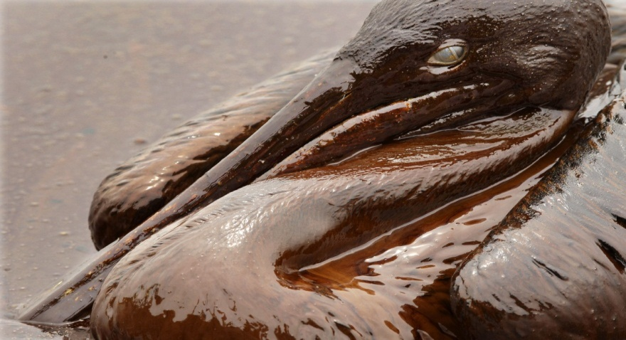
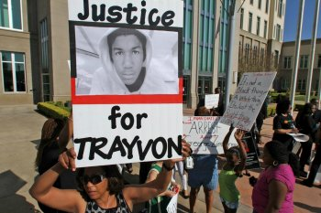
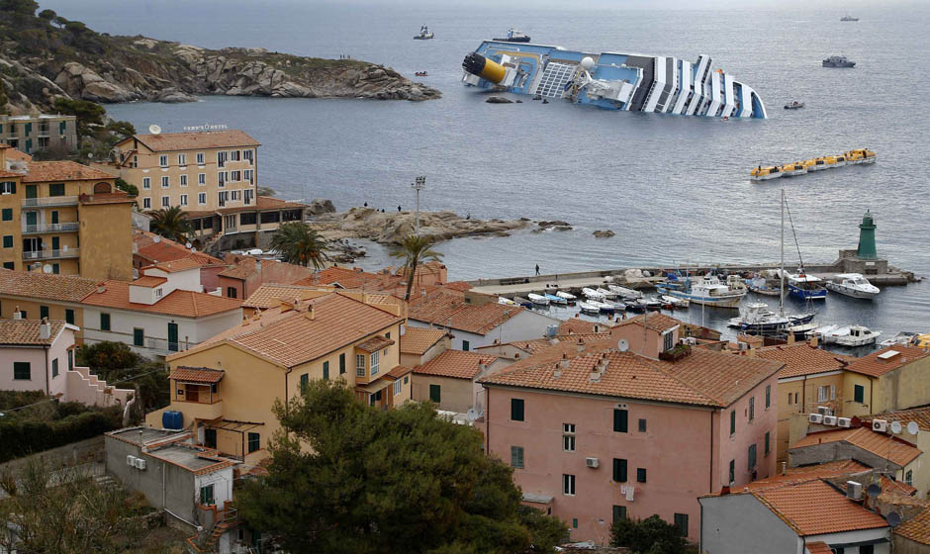
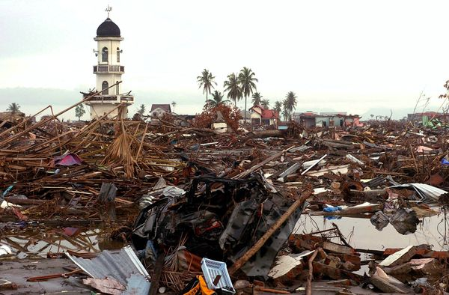
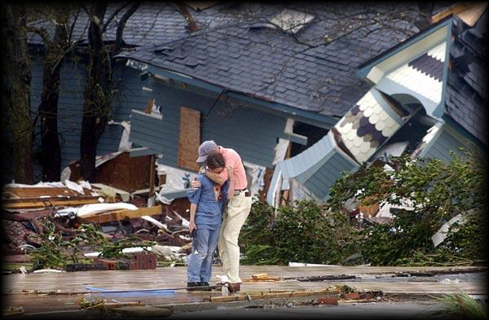
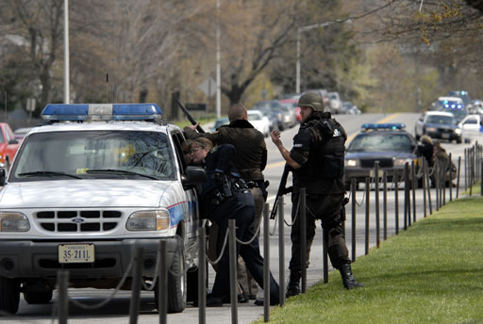
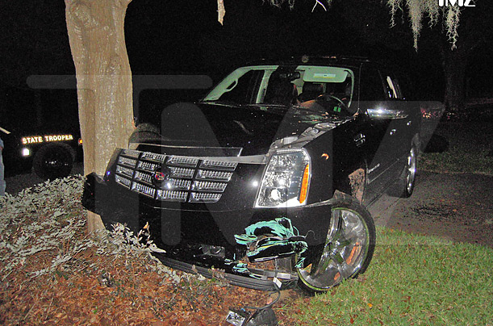
Crises
Notes:
Crises … images of some of the most memorable in the last decade.

Slide 3
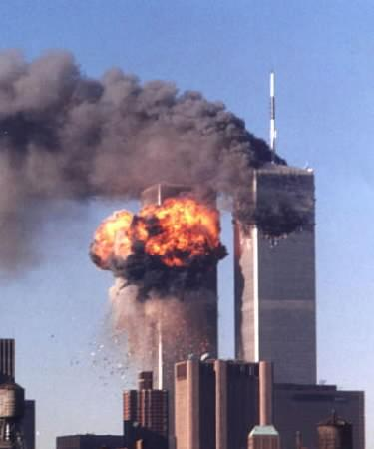
Crises Come in All Forms
911
Four simultaneous suicide attacks on September 11, 2001, resulted in the death of 2,996 people, including the 19 hijackers and 2,977 victims.

Slide 4
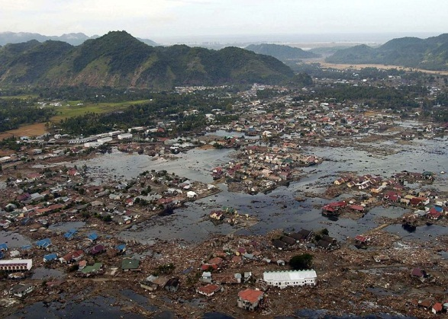
Crises Come in All Forms
Tsunami
December 26, 2004
Banda Aceh, the provincial capital and largest city in the province of Aceh, Indonesia, is located on the island of Sumatra. The city sustained damage following an earthquake in the Indian Ocean and 167,000 people died and many more were injured as a result of a tsunami, which struck shortly afterward.

Slide 5
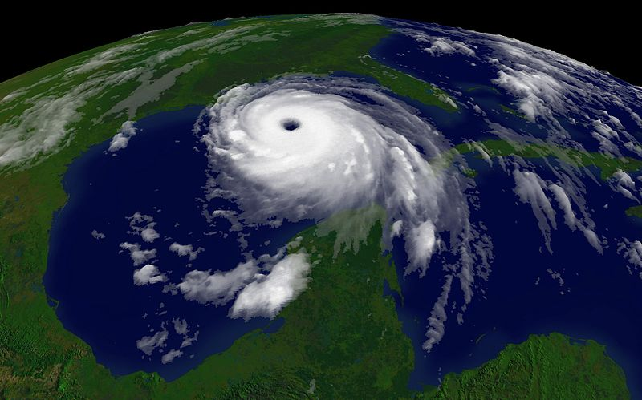
Crises Come in All Forms
Hurricane Katrina
August 29, 2005
One of the five deadliest hurricanes, in the history of the United States. At least 1,836 people died in the actual hurricane and in the subsequent floods.

Slide 6
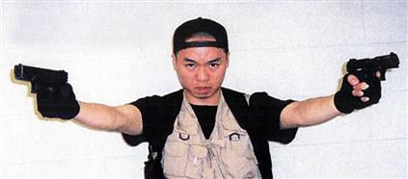
Crises Come in All Forms
Virginia Tech Shooting
April 16, 2007
Originally thought to be a contained domestic dispute, 33 people died, including the gunman, and dozens were injured.

Slide 7
Crises Come in All Forms
Costa Concordia, January 13, 2012
The Costa Concordia cruise ship ran aground off the west coast of Italy. Evacuation took over six hours and not all passengers were evacuated. Of the 3,229 passengers and 1,023 crew known to have been aboard, 32 passengers and crew perished in the tragedy. More than a dozen bodies were unrecovered when the search was ended due to safety concerns.

Slide 8
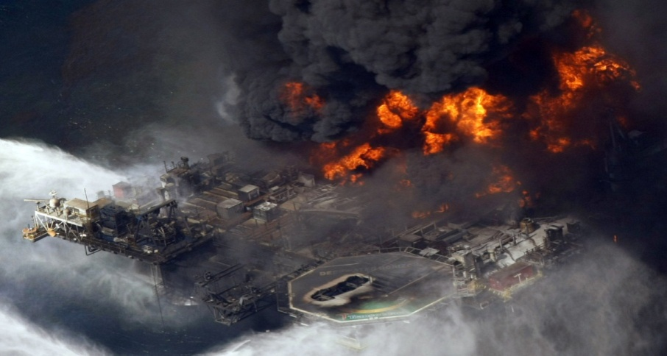
Crises Come in All Forms
Deepwater Horizon Oil Spill
April 20, 2010
Largest accidental marine oil spill in the history of the petroleum industry. Eleven dead, 17 injured, impact to wildlife and tourism.

Slide 9
Crises Come in All Forms
Tiger Woods Affair (s)
November 2009
Tiger Woods' affair impacted his career and the economy. According to research by two economics professors, it cost Tiger Woods' corporate sponsors $12 billion in lost stock value. Between November 25 and December 13, companies such as Gatorade, Nike and Electronic Arts stock prices fell 2.3%, costing shareholders $12 billion.

Slide 10
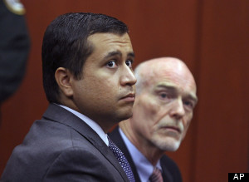
Crises Come in All Forms
Shooting of Trayvon Martin
February 26, 2012
Neighborhood watch captain George Zimmerman said he was acting in self-defense when he shot and killed 17-year-old Trayvon Martin, who was unarmed. The shooting ends one life, destroys another and leaves a community in turmoil. Racial allegations and questions about the Florida’s Stand Your Ground law once again bring the national spotlight to Central Florida.

Slide 11
Crises Come in All Forms
Aurora, Colorado Shooting
July 20, 2012
A masked gunman killed 12 people at a midnight showing of the "The Dark Knight Rises” in a Denver suburb sparking pandemonium when he hurled a teargas canister into the auditorium and opened fire on moviegoers. Fifty others including children were wounded in the attack.

Slide 12
Definition of a crisis
A crisis is a major occurrence with a potentially negative outcome affecting the organization, company, or industry, as well as its publics, products, services or good name.
A crisis interrupts normal business transactions and can sometimes threaten the existence of the organization.
A crisis can be a bankruptcy, boycott, fire, merger, murder, natural disaster, transportation accident, product recall, product tampering, strike, terrorism, et al.
Notes:
This is the textbook definition of a crisis. Negative outcome, reputation damage, interrupts normal operations, can threaten the existence of the company.
Look at the list of possibilities … but know they are endless.
Unfortunately it often takes a crisis to move organizations to create a plan. Don’t wait for a crisis to occur because no company, no city, no country, no individual is immune.

Slide 13
Common Denominators
No city, country, industry or organization (or individual) is immune.
Crises are unpredictable.
The media play a critical role (can make or break a crisis).
Crises have a financial impact, can damage reputation, or both.
Notes:
Here are the common denominators.
Some crises are “slow burn” … you have warning such as a multi-phase communication plan regarding the closing of the Brevard campus and weather emergencies,
Some are unexpected … handled media relations about the reopening of the investigation into the death of a former student, an alleged sexual assault on campus (which was not true and we knew it, but couldn’t say it),
At Rollins we began to implement the Incident Command System (ICS), a standardized, on-scene, all-hazards incident management approach.
With an electric utility, weather and injury are the most prevalent crises we would face. It’s a dangerous business.
In a large-scale weather emergency, at Duke, we implement a Joint Information Center – can handle communication from NC if Florida is affected and vice versa.

Slide 14
What can you do?
Research shows …
Companies with two-way communication often avoid crises or endure crises of shorter duration or of lesser magnitude.
Strong community presence and good relationships with media are beneficial.
Crisis management and crisis communication are key.
Training is essential.
Practice PR Excellence.
Notes:
PR is excellent when integral part of organization’s strategic management process and managed strategically.
PR is managed strategically when it identifies stakeholders and resolves issues.
PR head part of top management – If you don’t have a seat at the table have great relationships with those that do.
Programs build relationships with key stakeholders.
PR identifies and ranks stakeholders.
Ongoing plan is developed for each key stakeholder.
Segments large publics into smaller publics.
Issues management is part of two-way symmetrical program for early identification of crises.

Slide 15
What can you do?
Focus on Detection:
Watch for warning signs (prodomes).
When businesses in same industry have a crisis, this is a prodrome.
Focus on Prevention and Preparation:
Ongoing PR programs and regular two-way communication build relationships and help prevent or lessen crises.
Corporate culture with open interaction.
Corporate Social Responsibility and policies that prevent crises.
Training of key personnel to assess media inquiries (and contact the right person).
Prepare/update Crisis Communication Plan.
Notes:
There are five stages of a crisis … focus on two:
Detection and Prevention and Preparation.
Detection
Prevention/preparation
Containment
Recovery
Learning
Before, during and after crises continue the scans.
Watch your industry for crises and evaluate if that can happen in your organization. These are prodromes or warnings. The prodrome for the Costa Concordia was the Titanic!

Slide 16
What can you do?
Communications to Prevent Crises
Strong community relations program.
Ongoing positive media coverage.
People-centered corporate culture vs. profit-centered.
Listening to internal publics to determine likely prodromes.
Notes:
Tylenol is a great example of a company that put people before profits.

Slide 17
In Today’s Environment
Environmental impacts …
Shrinking of traditional media.
Can’t rely on publicity to reach target audience in good times or bad.
Growth of social media and new media.
The Virginia Tech tragedy changed Facebook – it became a news channel.
Explosion of “Citizen” journalism.
Use all available tools and invest in new technology for speed.
Don’t underestimate social media.
Never forget the power of good, old-fashioned face to face communications.
Notes:
Environmental impacts are blurring the lines:
Shrinking of traditional media
Can’t rely on publicity to reach audience
Reduction in advertising (fewer outlets/smaller budgets)
Growth of social and new media
“Citizen” journalism
New tools like Rave Alert
Virginia Tech & Facebook
This tragedy was a turning point.
Previously a fun network, but media was getting info from Facebook.
College webserver was down, cell phones were jammed, emergency service agencies in discovery.
Students posted to Facebook, uploaded photos to Flickr and blogged.

Slide 18
The Golden Hour
Be among the first—if not the first—to know when
a crisis occurs.
“Bad things happen to people and organizations all the time, and it isn’t the severity of the negative event that determines whether they suffer reputational, operational, or financial harm, but rather the nature and timeliness of the response.”
—Helio Fred Garcia, president and founder of the Logos Consulting Group and co-author of Reputation Management: The Key to Successful Public Relations and Corporate Communication.
Notes:
Start communications as soon as possible in the “Golden Hour” – the first hour following notification that the crisis has occurred.
If accurate data isn’t transmitted … inaccurate data is.
They’re going to do the story with or without you … you should participate and try to control the messages. With social media, today organizations have an hour to respond.
Have plans, stock messages.
The tools … traditional media vs. social media.
Doing the story with or without you … best to be involved and manage the story.
Do not assume the crisis will go away.
Media can become adversarial … they believe they are there to protect the public.
Rudi Guiliani spoke immediately and often.
Tiger Woods didn’t speak for months.

Slide 19
What can you do?
Speak with One Clear Voice to Build Trust
Internal communications – engage employees and build trust.
External communications – earn stakeholder trust and support.
Publicity – build public trust and support.
Notes:
Media may seek out employees and the community for feedback.
Prepare your employees and your community advocates.
Third party endorsements have a lot of credibility.

Slide 20
What can you do?
One of the first steps in your Crisis Communications Plan is to do a Crisis Inventory for your company.
Prepare a list of the likely crises.
Answer the following questions:
How likely is the crisis?
How devastating can the crisis be?
Plan for crises ranked high in probability and damage.
The ranking can introduce ideas for prevention programs and may demonstrate vulnerability.
Notes:
Plan for crises ranked high in probability and damage.
Utility – storms, injuries, unhappy customers.
Banks – robberies, embezzlement.
Hospitals – infections, surgery “accidents,” deaths
Watch your industry for “trends” or possibilities.
Watch tv and movies – which came first the chicken or the egg? Does art imitate real life or does real life spark ideas (e.g., Grey’s Anatomy).
I taught Crisis Communications at Rollins last fall and it’s an amazing thing to teach what you do. You dissect things and view them differently. We examined nearly a dozen case studies through the course. One of the worst examples of crisis management is Hurricane Katrina.

Slide 21
One of the Worst
Natural disasters aren’t an organization’s fault, but are blamed if a sense of normalcy isn’t restored quickly.
Hurricane Katrina
As much a manmade disaster as a natural disaster.
80 percent of New Orleans below sea level.
Levees and floodwalls built for 95% of hurricanes.
Lower Ninth Ward built in swampland.
Poor planning and lack of action.
Multiple prodromes—National Geographic magazine, Times-Picayune , corps of engineers warned about Category 4 and 5 storms.
Hurricane was bad … flooding followed ... 1,000 died.
Notes:
Planning challenges:
Evacuation plans didn’t consider certain segments of the population … those without their own transporation.
People were evacuation weary–too many false alarms.
Advance media treatment may not have been strong enough or people didn’t get the message. Was there equal access to media? Not everyone got the newspaper.
CMP and CCP weren’t developed for worst case scenario.
CMP depended on phone. Needed basic equipment like bullhorns, satellite phones, generators, alert systems. Also alternate location.
Crisis beyond capability of state and local governments.
Families separated.
People didn’t bring supplies to Superdome.
Not only was the crisis managed badly, but communication was flawed.
Media covered and exacerbated the crisis—didn’t help.
The primary source of communication was rumor.

Slide 22
One of the Best
US Airways and “The Miracle on the Hudson”
Newly-updated Crisis Communication Plan by brand new VP James Olson.
Table top drill three weeks before Flight 1549 emergency landed in the Hudson. Half-day summit with “first responder” teams from other areas of the company.
Amazing composure from Captain “Sully” Sullenberger.
PR team mobilized immediately. “War room” was set up within minutes not months.
US Airways wanted to be more accurate than fast.
Put up dedicated Flight 1549 website and marketing purchased key words to direct inquiries to official site.
US Airways Care Team—Amazing customer service.
A model of crisis management.
Notes:
Non-expert experts and news media reported that everyone was safe.
Took 24 hours to confirm that everyone was safe … they were boarded onto different boats and ferries and taken to different locations.

Slide 23
The Crisis Communication Plan
The Plan
Cover page • Equipment and supplies
Introduction • Pregathered information
Acknowledgements • Key messages
Rehearsal dates • Website
Purpose and objectives • Blogs and social media
List of key publics • Trick questions
Notifying publics • List of prodromes
Identifying the crisis communications team • List of related Internet URLs
Crisis directory • Evaluation form
Identifying the media spokesperson
List of emergency personnel and local officials
List of key media
Spokespersons for related organizations
Crisis communications control center
Notes:
Have a plan on the shelf. Here are the elements.
Practice the plan.
Conduct media training for your Executives and Subject Matter Experts.
Your Crisis Communication Plan helps you communicate the right message to the right people at the right time.

Slide 24
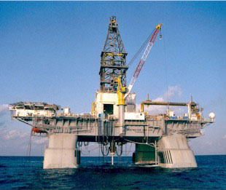
The Importance of Words
BP Oil Spill
Largest accidental marine oil spill in the history of the petroleum industry.
Stemmed from a sea-floor oil gusher as a result of the explosion of Deepwater Horizon on April 20, 2010.
Killed 11 men killed and injured 17.
Flowed unabated for three months in 2010, and may be continuing to seep.
Caused extensive damage to marine and wildlife habitats and to the Gulf's fishing and tourism industries.
The Deepwater Horizon was a 9-year-old
semi-submersible mobile offshore
drilling unit.
Notes:
The importance of Words … message development is critical and so is training … and sticking to key messages.

Slide 25
The Importance of Words
An apology undone by five little words …
“I'm sorry. We're sorry for the massive disruption it's caused their lives. There's no one who wants this over more than I do. I'd like my life back.”
Tony Hayward, CEO
BP Oil
http://www.youtube.com/watch?v=MTdKa9eWNFw
Notes:
BP Oil
Five little words.
Anthony Bryan "Tony" Hayward (born 21 May 1957) is a British businessman, the former chief executive of oil and energy company BP. He replaced John Browne, Baron Browne of Madingley on 1 May 2007. His tenure ended on 1 October 2010 due to his weak management of the Deepwater Horizon oil spill.[1] He was replaced by Bob Dudley.

Slide 26
The Importance of Words
Statements made by Ben Hatfield and widely quoted in the media
“As I told you in the last media update, we are incredibly saddened by the turn of events. We understand the grief and despair and anger. I’m not surprised by it.”
“These people have endured incredible pain over the last 2 to 3 days just as we did.”
“In the process of being cautious, we allowed the jubilation to go on longer than it should have. That’s just all I can say about it.”
Notes:
RATE THESE QUOTES
Ben Hatfield, West Virginia mining company CEO in 2006 regarding a methane exposition at the mine. Thirteen miners were trapped for almost three days. When rescuers reached them, inaccurate information “they are all alive” was radioed to the emergency operations center. Three hours went by and the mining company admitted only one person survived. This is the press conference immediately following the announcement. When paired with the exercise to rate each quote on paper, we learn:
The power of putting a face on a story to convey emotion and credibility
The different perceptions people have of the written vs. spoken word
Importance of context

Slide 27
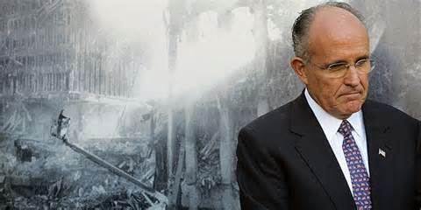
WWRD?
Rudy Giuliani is widely praised
for his actions during 911.
He communicated quickly, calmly, clearly,
often, honestly, directly:
Constantly present.
Provided a sense of security.
He was human and emotional.
Connected with people.
He made it larger than NYC – it was an attack on mankind and the American way of life.
Notes:
Mayor Rudy Guiliani communicated quickly, calmly, clearly, often, honestly, directly:
Constantly present
Provided a sense of security
He was human and emotional
Connected with people
He made it larger than NYC – attack on mankind and the American way of life.

Slide 28
Top Ten Pieces of Advice
Practice PR Excellence.
Prepare for the worst.
Be a great issues manager and anticipate crises.
Plan, practice and train. And then do it again.
Know that you can never imagine every scenario.
Control the message and tell your own story.
Speed is important, but accuracy is more important.
Don’t assume it’s going to go away.
Don’t underestimate the power of social media.
Trust your gut … be human.

